Slide 1
Meet the Team
Vaibhav Thalanki
Anand Singh
Chaitanya Agarwal

Slide 2
HODL My Taxes: dApp for Tax Compliance on Online Gambling Platforms
A DECENTRALIZED APPLICATION FOR AUTOMATIC TAX WITHHOLDING AND REPORTING FOR PLAYERS, OPERATORS, AND GOVERNMENTS.

Slide 3
Online gambling wins are hard to track for taxes
1
Problem Statement
Manual reporting is inefficient, error-prone, and costly
2
Governments lose money, players face audit risks, operators face compliance burdens
3

Slide 4
Why this matters?
USER BENEFITS
BENEFITS FOR IRS
Urgent need for automatic, auditable, trustless tax solutions.
Independently generate verifiable records for tax filings.
Download detailed transaction histories.
Tax misrepresentation = billions lost annually
Tax filings are cryptographically verifiable - cutting down manual audits.
Less paperwork, fewer manual reconciliations, and faster resolutions.

Slide 5
Our Solution (1)
Automates the recording and calculation of online gambling-based taxes using smart contracts:
Players record transactions categorized as Income, Expense, or Capital Gain.
Players can calculate their tax owed based on recorded income.
Players will be issued verifiable tax proofs linked to their recorded ledgers.
Tax authorities can aggregate and review all user transaction histories transparently.
https://hodl-my-taxes.vercel.app/

Slide 6
Our Solution (2)
https://hodl-my-taxes.vercel.app/

Slide 7
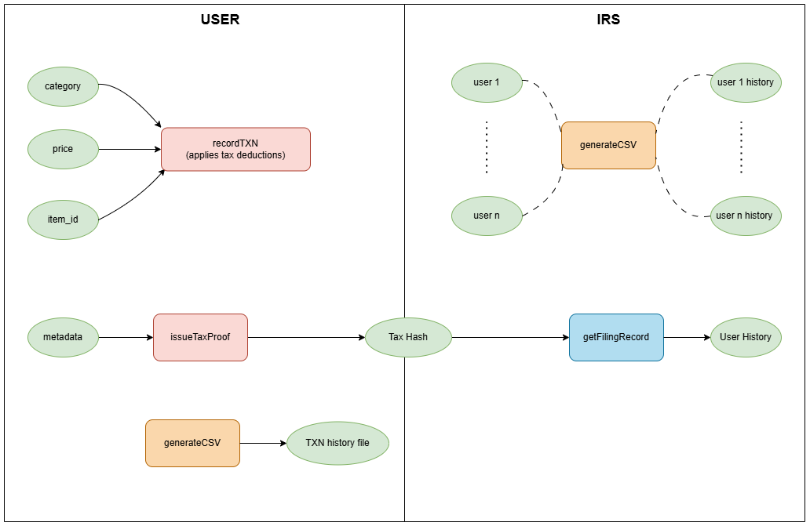
How it works

Slide 8
1
2
Automatic tax withholding at payout
No extra work for players
Core Features
3
4
Fully auditable for regulators
Scalable to multiple jurisdictions

Slide 9
Market Potential
Online gambling is growing exponentially.
Average revenue per user (ARPU) is projected to amount to $492.19 in 2025.
Governments lose billions annually due to unreported and underreported winnings.
Compliance demands are increasing worldwide, manual systems cannot keep up.

Slide 10
Future Work
Offer APIs and SDKs for gambling platforms and applications
Dynamic tax rates based on player demography
Support for one user, multiple wallets
Scheduling automated report generation and tax filing
Fetching ledger snapshots associated with a specific transaction hash, allowing targeted investigation or audits.

